Slide 1

Generative AI and its Applications
ELMO, Transformer Anatomy
Dr. Pooja Agarwal
Department of Computer Science and Engineering

Slide 2

Generative AI and its Applications
(UE23CS342BA4)
We have covered:
LLM Basics and evolution
NLP: Word Embeddings
POS and NER
Text Classification
We will now cover:-
ELMo, Transformer Anatomy,
BERT,GPT, ROBERTa, BART architectures

Slide 3
Generative AI and its Applications
(UE22CS342BA9)
Transformers (2017): Introduced the fundamental architecture for LLMs.
ELMo (2018): Leveraged context-sensitive embeddings using bi-directional LSTMs.
GPT (2018): Built on transformer architecture for text generation.
BERT (2018): Utilized transformers bidirectionally for better context understanding.
RoBERTa (2019): Enhanced BERT with optimized training methods.
BART (2019): Combined encoder-decoder frameworks from BERT and GPT.

Slide 4
Generative AI and its Applications
(UE22CS342BA9)
ELMo
Dr. Pooja Agarwal
Department of Computer Science and Engineering

Slide 5
ELMo
ELMo (Embeddings from Language Models) represents a groundbreaking approach to word embeddings that fundamentally changed how we represent words in natural language processing.
Released in 2018 by researchers at the Allen Institute for Artificial Intelligence and the University of Washington, ELMo introduced the concept of contextual word representations, moving beyond the limitations of static word embeddings.
References:
Deep Contextualized Word Representations (Peters et al., NAACL 2018)

Slide 6
ELMo: Architecture and Working
Bidirectional Processing
ELMo employs a two-layered bidirectional LSTM network that processes text in both forward and backward directions.
It addresses the limitations of traditional word embeddings by introducing ELMo, which captures both the complex characteristics of word use (syntax and semantics) and how these uses vary across different contexts (polysemy).
Deep Contextualized Word Representations (Peters et al., NAACL 2018)

Slide 7
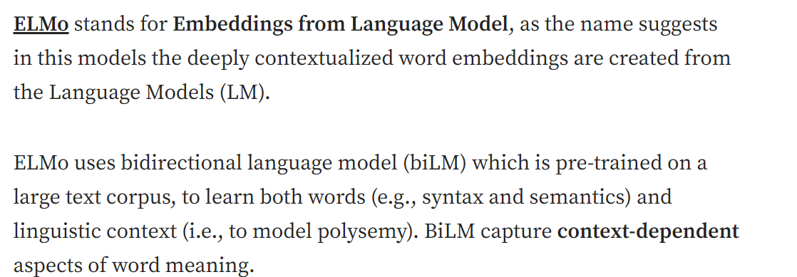
ELMo: Architecture and Working
Deep Contextualized Word Representations (Peters et al., NAACL 2018)

Slide 8
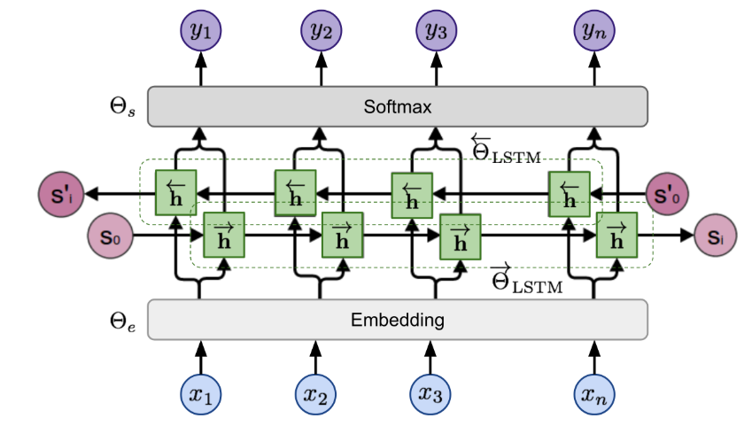
ELMo
References:
Generalized Language Models | Lil'Log

Slide 9
ELMo: Architecture and Working
Bidirectional Processing
The model begins with character-level tokenization, converting words into character embeddings before processing them through:
A forward pass capturing preceding context
A backward pass capturing subsequent context
Two LSTM layers with residual connections

Slide 10
ELMo: Architecture and Working
ELMO
Lower layers of ELMO capture syntactic features (e.g. POS tag)
Higher layers capture semantic feature (like word sense disambiguation)

Slide 11
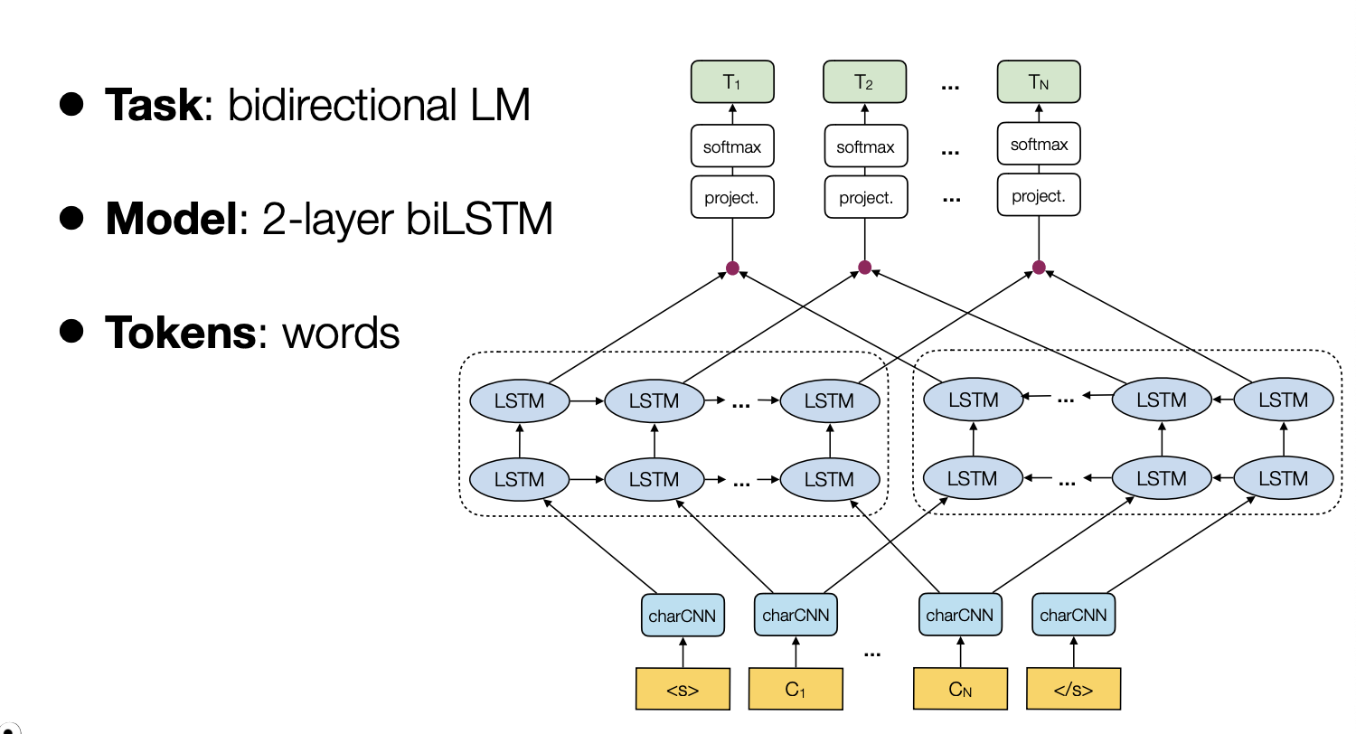
ELMo: Architecture and Working
ELMO

Slide 12
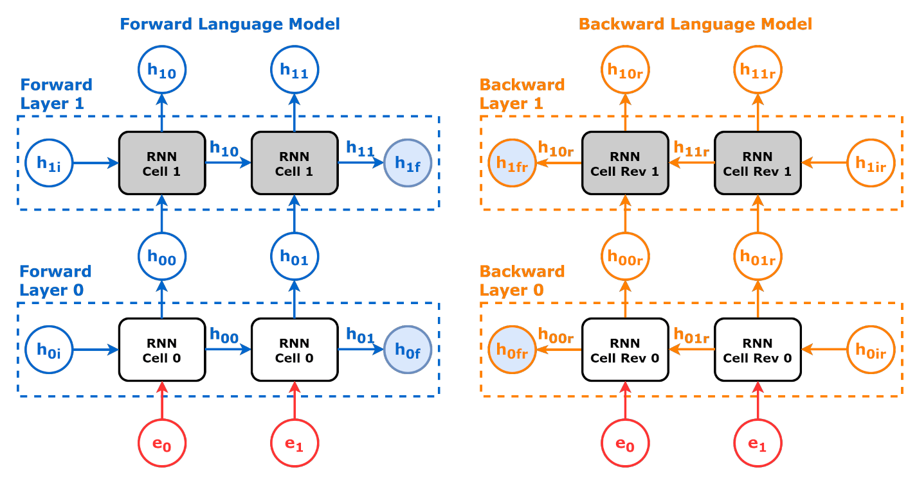
ELMo: Architecture and Working
ELMO

Slide 13
ELMo: Architecture and Working
ELMo, short for Embeddings from Language Model (Peters, et al, 2018) learns contextualized word representation by pre-training a language model in an unsupervised way.
The bidirectional Language Model (biLM) is the foundation for ELMo.
While the input is a sequence of n tokens, (x1,…,xn) the language model learns to predict the probability of next token given the history.
In the forward pass, the history contains words before the target token,
In the backward pass, the history contains words after the target token,

Slide 14



ELMo: Architecture and Working
Bidirectional Processing
Given a sequence of N tokens , a forward language model(LM) computes the probability of the sequence by modeling the probability of token t_{k} given the history :
A backward LM is similar to a forward LM, except it runs over the sequence in reverse, predicting the previous token given the future context

Slide 15
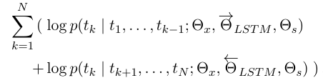

ELMo: Architecture and Working
Bidirectional Processing
A biLM combines both a forward and backward LM.
The formulation jointly maximizes the log likelihood of the forward and backward directions:
$$where {\vec{θ}}_{LSTM }represents the parameters of the forward LSTM$$
$$network and {\overset{⃖}{θ}}_{LSTM} represents backward LSTM network$$

Slide 16
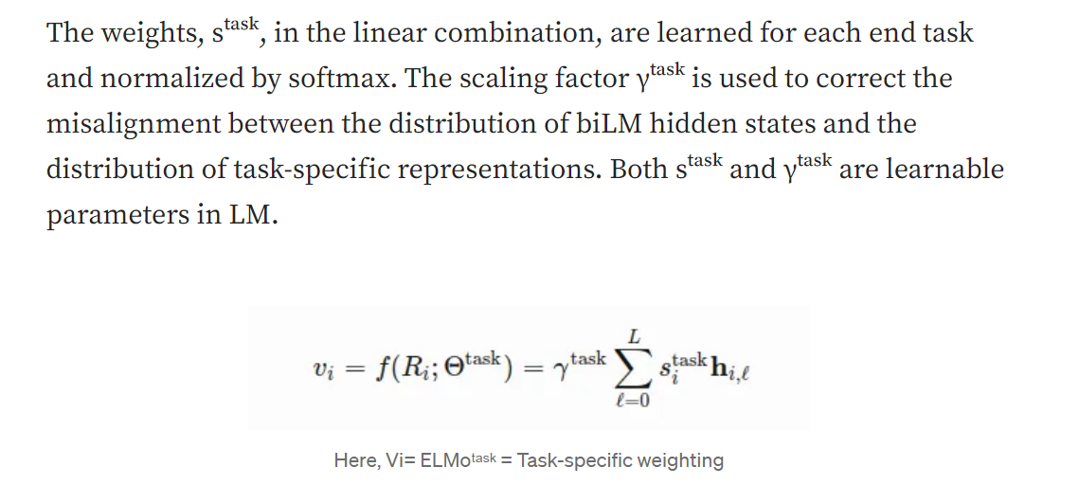
ELMo: Architecture and Working

Slide 17
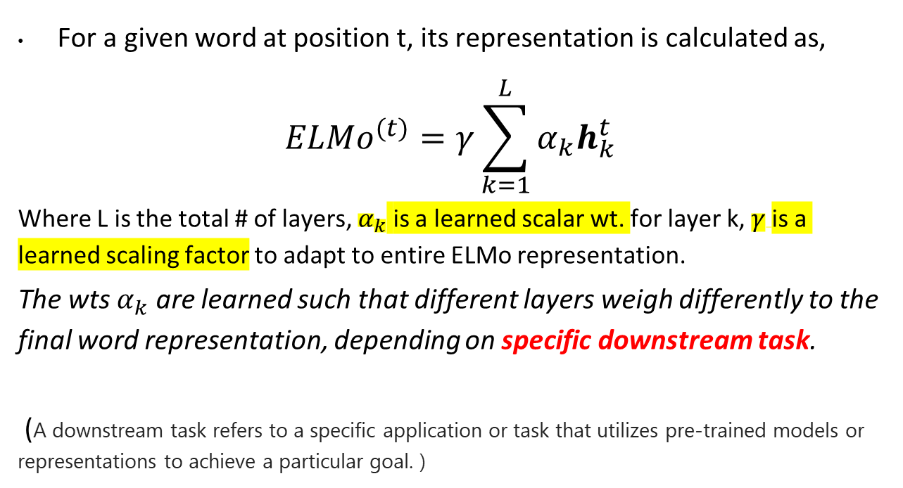
ELMo: Architecture and Working
For a given word at position t, its representation is calculated as,
$${ELMo}^{(t)}=γ\sum_{k=1}^{L}{α_{k}h_{k}^{t}}$$
Where L is the total # of layers, $α_{k}$ is a learned scalar wt. for layer k, $γ$is a learned scaling factor to adapt to entire ELMo representation.
The wts $α_{k}$ are learned such that different layers weigh differently to the final word representation, depending on specific downstream task.
(A downstream task refers to a specific application or task that utilizes pre-trained models or representations to achieve a particular goal. )

Slide 18
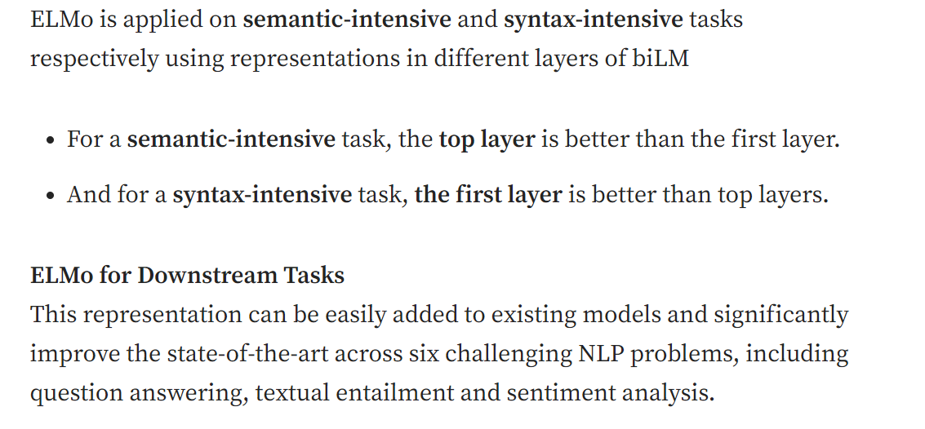
ELMo

Slide 19
ELMo
Architecture and Working
Context-Aware Understanding
Dynamic Word Representations:
Unlike traditional word embedding methods like Word2Vec or GloVe, ELMo generates different representations for the same word based on its context. For example, the word "trust" receives distinct embeddings in phrases like:
"I can't trust you"
"He has a trust fund"
This context sensitivity allows ELMo to handle:
Polysemy (multiple word meanings)
Complex linguistic patterns
Contextual nuances

Slide 20
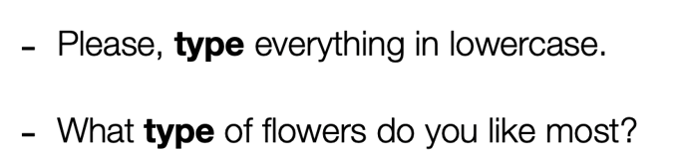
ELMo
Architecture and Working
Context-Aware Understanding
Some more example:-

Slide 21
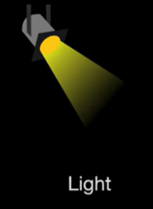
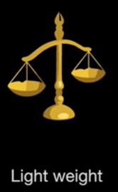
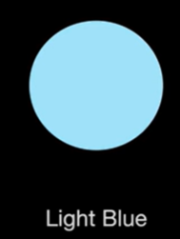

Contextual Word Representation

Slide 22
ELMo
Training and Implementation
ELMo was trained on an impressive corpus of approximately 30 million sentences and 1 billion words. The training process involves:
Pre-training Phase
Language modeling task predicting next/previous words
Character-level processing for handling unknown words
Bidirectional training for comprehensive context understanding
Fine-tuning Phase
Task-specific adaptation
Integration with downstream NLP tasks
Frozen base parameters with adjustable projection matrix

Slide 23
ELMo
Fine-tuning Phase
Task-specific adaptation:
Tailor the pre-trained ELMo representations to perform well on a specific NLP task (e.g., sentiment analysis, named entity recognition).
This involves training additional layers or parameters that are specific to the task while leveraging the pre-trained ELMo embeddings.
Weighted combination of layer outputs using softmax normalized weights and scaling factor optimizes embedding for downstream tasks.
Integration with downstream NLP tasks: Seamlessly incorporate the fine-tuned ELMo representations into various NLP tasks.

Slide 24
ELMo
Fine-tuning Phase
Frozen base parameters with adjustable projection matrix:
The core parameters of the pre-trained ELMo model (i.e., the weights of the bidirectional language model) are kept fixed during the fine-tuning phase. This ensures that the rich contextual information captured during pre-training is preserved.
A task-specific projection matrix is introduced, which can be adjusted during fine-tuning. This matrix maps the ELMo embeddings to a space that is more suitable for the specific task at hand. By adjusting this matrix, the model can better align the pre-trained embeddings with the requirements of the downstream task.

Slide 25
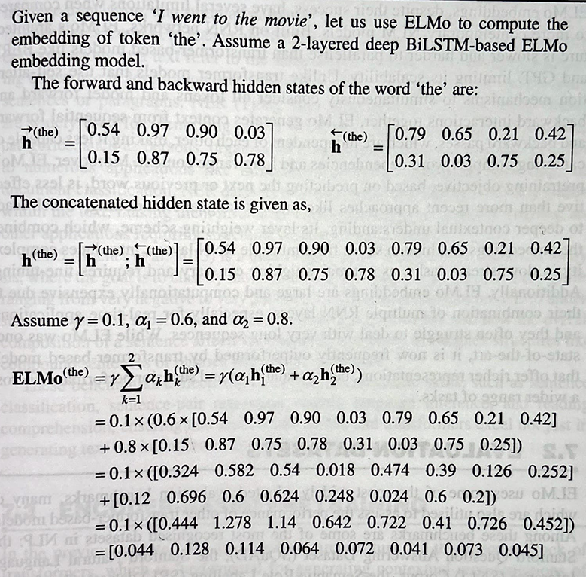
ELMo: An example

Slide 26
Example

Slide 28
ELMo
Deep contextualized word representations Peters et al. (AllenNLP)
OpenAI GPT
Improving Language Understanding by Generative Pre-Training Radford et al.(OpenAI)
BERT
BERT: Pre-training of Deep Bidirectional Transformers for Language Understanding Devlin et al. (Google)

Slide 29
Generative AI and its Applications
Transformers Anatomy
Course Instructor: Dr. Pooja Agarwal
Department of Computer Science and Engineering

Slide 30
Generative AI and its Applications
Transformer Anatomy
Disadvantages of RNN
Attention and Attention Mechanism
Encoder and Decoder
Positional Encoding
Transformer Anatomy
Decoder – Masked Multi-Head (Self) attention

Slide 31
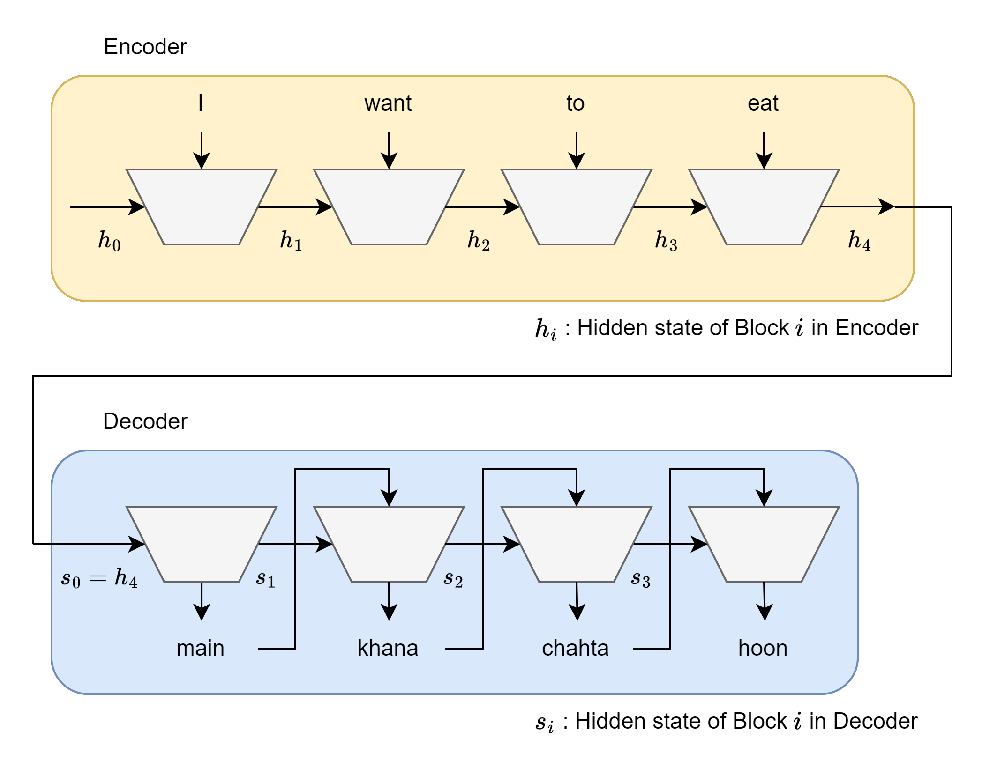
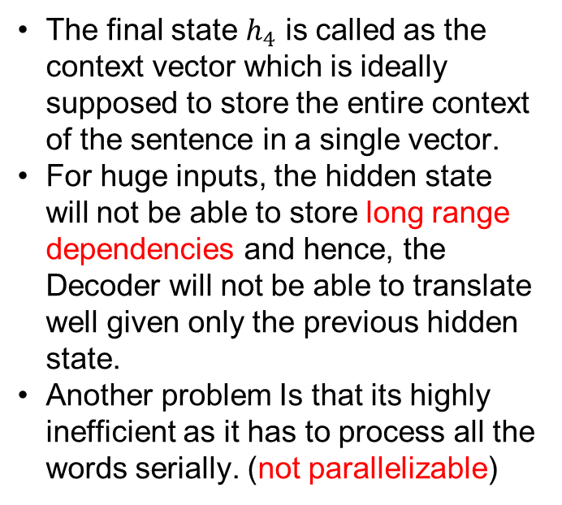
Generative AI and its Applications
Disadvantages of RNN
Let’s take an example of Sequence to Sequence RNN Model for machine translation (English to Hindi) for the following sentence
The final state $h_{4}$ is called as the context vector which is ideally supposed to store the entire context of the sentence in a single vector.
For huge inputs, the hidden state will not be able to store long range dependencies and hence, the Decoder will not be able to translate well given only the previous hidden state.
Another problem Is that its highly inefficient as it has to process all the words serially. (not parallelizable)

Slide 32
Generative AI and its Applications
Attention
In the context of the Transformer model, attention refers to a mechanism that
determines which parts of an input sequence are most relevant for generating
the output at a specific time.
Key Ideas:
Self-Attention: Each token in a sequence focuses on all other tokens to capture relationships and context, regardless of their position.
Query, Key, and Value: These are vector representations of input tokens. Attention scores are computed as a function of queries and keys, determining how much "attention" each token pays to others.
Weighted Summation: The final output is a weighted sum of the values, based on the
computed attention scores.
.

Slide 33
Generative AI and its Applications
Attention and Attention Mechanism
Attention:
Refers to the ability of a model to focus on different parts of the input sequence when making predictions, especially in sequence-to-sequence tasks like machine translation.
It determines how much weight or importance each element in the input sequence should have when predicting each element of the output sequence.
Attention Mechanism:
This is used to take care of LONG RANGE DEPENDENCIES.
This is the actual computational framework or algorithm that enables attention. It is the mathematical structure that allows the model to compute which parts of the input sequence should be given more importance (i.e., higher weights) when making a decision at each step.
It is realized through a scaled dot-product attention, where the input tokens are transformed into query, key, and value vectors, and the attention score is computed using the dot product of the query and key vectors.

Slide 34
Generative AI and its Applications
Attention
“As the animal entered the forest, … blending it into the shadows of the
towering trees.”
Here, “it” refers to “animal” earlier in the sentence.
RNN’s have a short reference window; if the input is too big, “it” ‘s reference will not be stored in the context window.
LSTM’s and GRU’s have a slightly better reference window.
The proposed Attention Mechanism in theory has an infinite reference window.
RNN’s window-
As the animal entered the forest, … blending it into the shadows of the towering trees.
LSTM’s window-
As the animal entered the forest, … blending it into the shadows of the towering trees.
Attention window-
As the animal entered the forest, … blending it into the shadows of the towering trees.

Slide 35
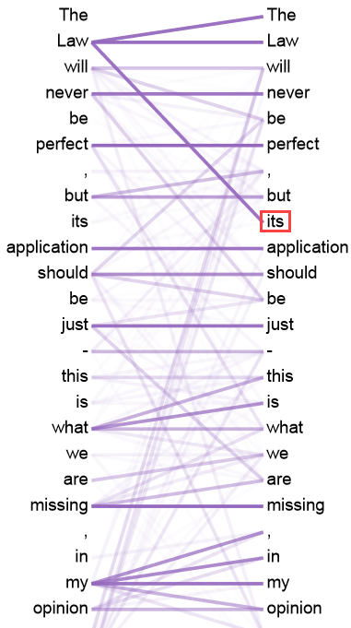
Generative AI and its Applications
Attention
Here, the word “its” has a strong reference to the
Word “Law”.
Since, we are finding attention between words of the same sentence, this is called self-attention.
If we instead computed attention between words of different sentences, this is called cross-attention.
Eg: attention between every word of “I want to eat” and “main khana chahta hoon”
Attention tells the model what parts of the sentence to focus on.
Picture Credit

Slide 36
Generative AI and its Applications
Attention
For each word in the sentence, we need to compute a relational score between
the word and every other word in the sentence.
The higher the score, the more related they are contextually or on some parameter.
Relational Score (Attention Score):
The relational score is computed as the dot product of the Query vector of one word and the
Key vector of another word.
This dot product gives a measure of similarity between the two vectors,
which translates to how much attention one word should give to the other.
The formula to calculate the attention score is:
Attention Score=Q⋅K
Where Q is the Query vector of the current word. K is the Key vector of another word.
Q⋅K represents the dot product of the two vectors.
Table Credit

Slide 37
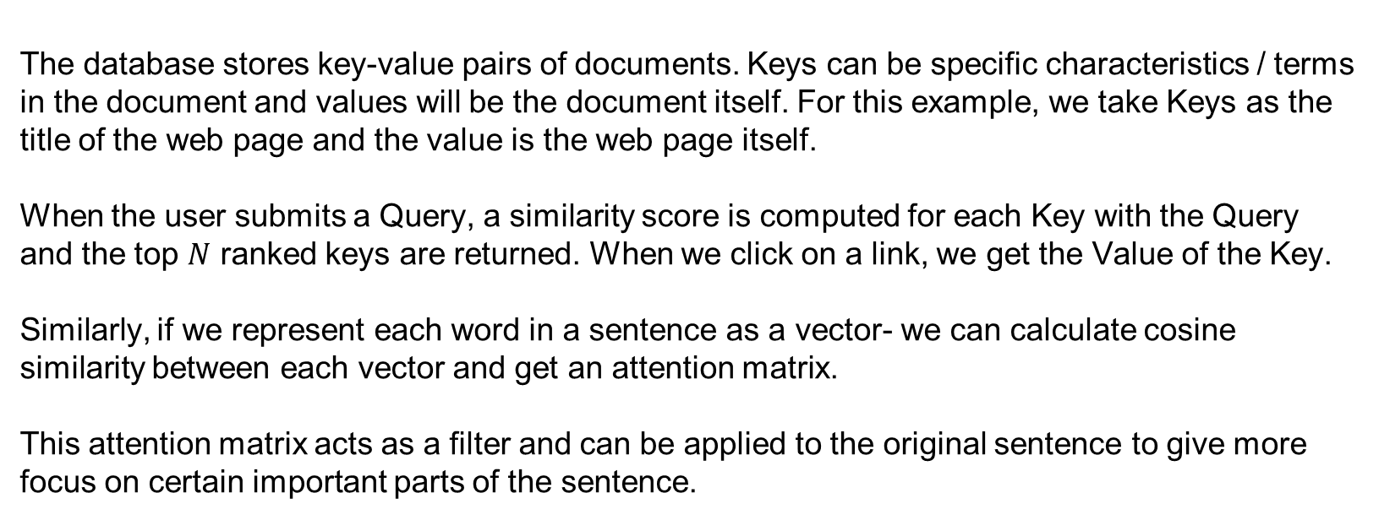
Generative AI and its Applications
Attention
The database stores key-value pairs of documents. Keys can be specific characteristics / terms
in the document and values will be the document itself. For this example, we take Keys as the
title of the web page and the value is the web page itself.
When the user submits a Query, a similarity score is computed for each Key with the Query
and the top $N$ ranked keys are returned. When we click on a link, we get the Value of the Key.
Similarly, if we represent each word in a sentence as a vector- we can calculate cosine
similarity between each vector and get an attention matrix.
This attention matrix acts as a filter and can be applied to the original sentence to give more
focus on certain important parts of the sentence.
Reference

Slide 38
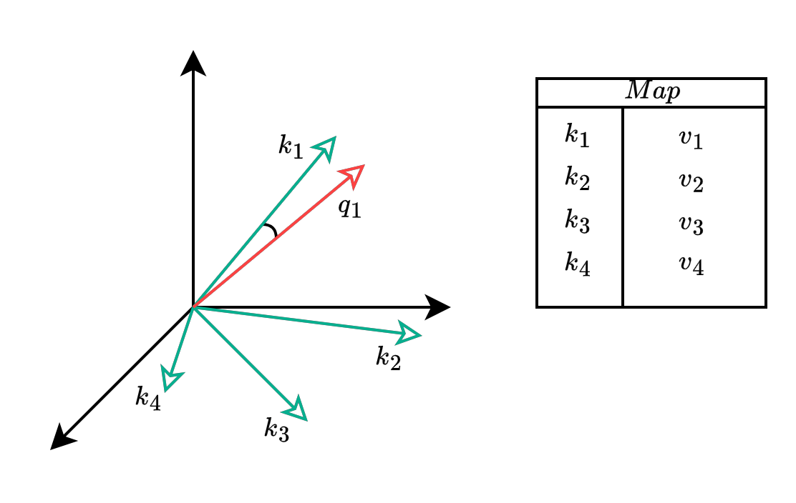
Generative AI and its Applications
Attention

Slide 39
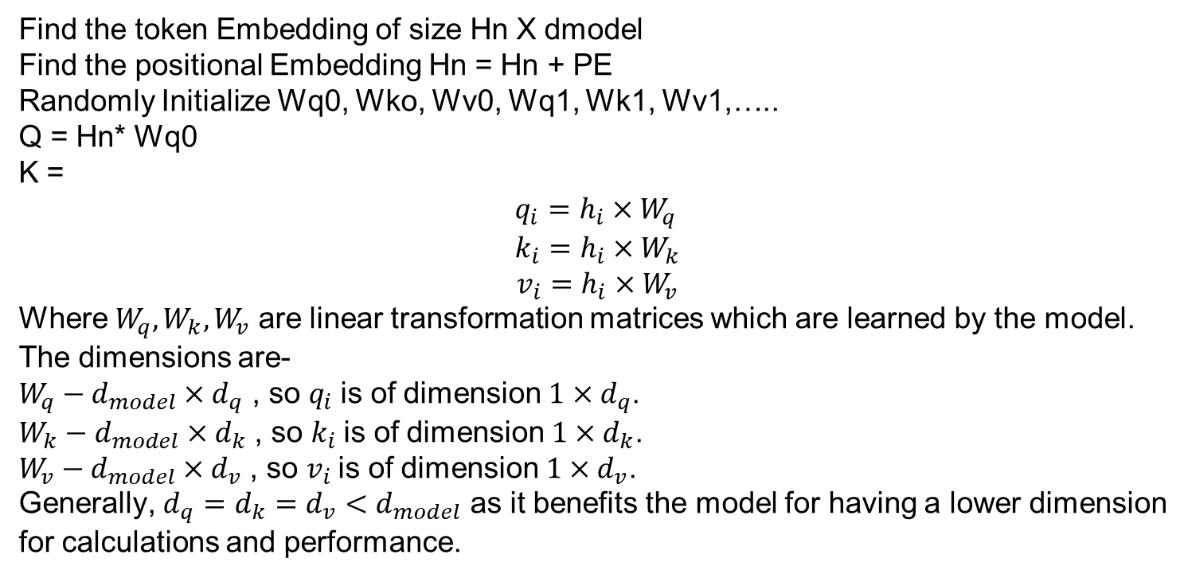
Generative AI and its Applications
Attention
Find the token Embedding of size Hn X dmodel
Find the positional Embedding Hn = Hn + PE
Randomly Initialize Wq0, Wko, Wv0, Wq1, Wk1, Wv1,…..
Q = Hn* Wq0
K =
$$q_{i}=h_{i}×W_{q} \\ k_{i}=h_{i}×W_{k}$$
$$v_{i}=h_{i}×W_{v}$$
Where $W_{q}, W_{k}, W_{v}$ are linear transformation matrices which are learned by the model.
The dimensions are-
$W_{q}−d_{model}×d_{q}$ , so $q_{i}$is of dimension $1×d_{q}$.
$W_{k}−d_{model}×d_{k}$ , so $k_{i}$is of dimension $1×d_{k}$.
$W_{v}−d_{model}×d_{v}$ , so $v_{i}$is of dimension $1×d_{v}$.
Generally, $d_{q}=d_{k}=d_{v}<d_{model}$ as it benefits the model for having a lower dimension
for calculations and performance.

Slide 40
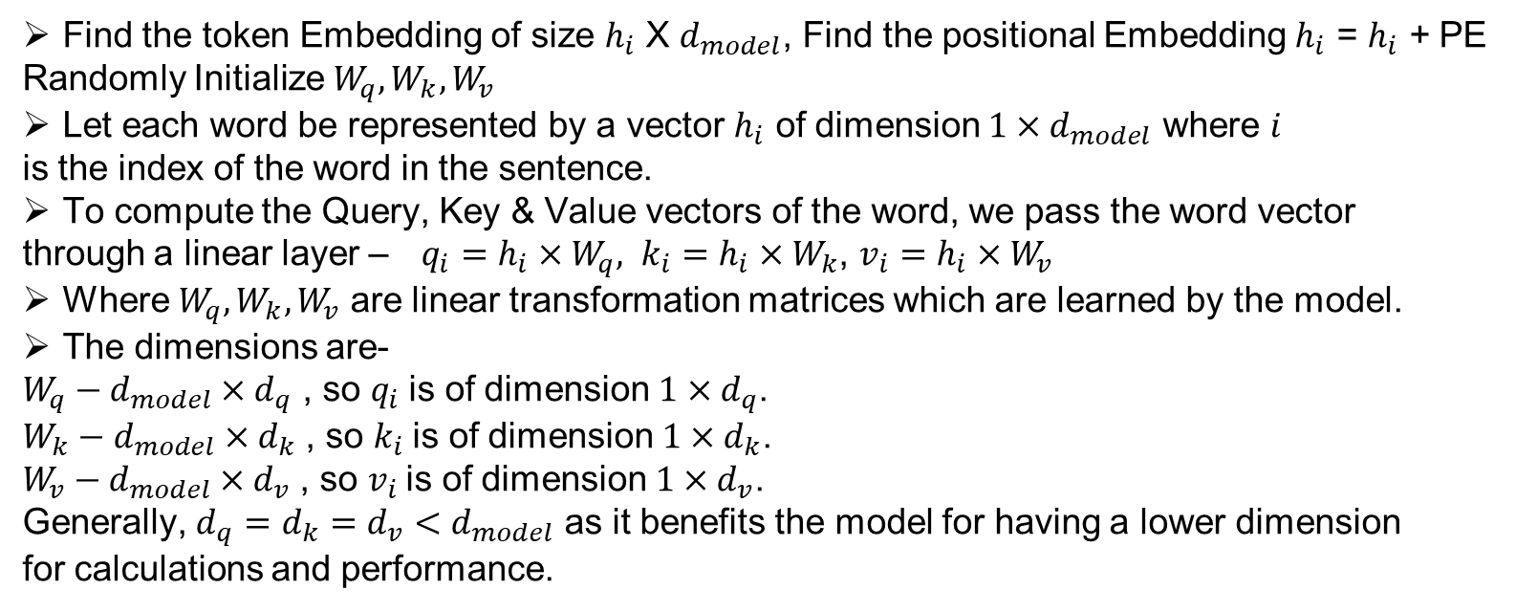
Generative AI and its Applications
Attention
Find the token Embedding of size $h_{i}$ X $d_{model}$, Find the positional Embedding $h_{i}$ = $h_{i}$ + PE
Randomly Initialize $W_{q}, W_{k}, W_{v}$
Let each word be represented by a vector $h_{i}$ of dimension $1×d_{model}$ where $i$
is the index of the word in the sentence.
To compute the Query, Key & Value vectors of the word, we pass the word vector
through a linear layer –$q_{i}=h_{i}×W_{q}, k_{i}=h_{i}×W_{k}$, $v_{i}=h_{i}×W_{v}$
Where $W_{q}, W_{k}, W_{v}$ are linear transformation matrices which are learned by the model.
The dimensions are-
$W_{q}−d_{model}×d_{q}$ , so $q_{i}$is of dimension $1×d_{q}$.
$W_{k}−d_{model}×d_{k}$ , so $k_{i}$is of dimension $1×d_{k}$.
$W_{v}−d_{model}×d_{v}$ , so $v_{i}$is of dimension $1×d_{v}$.
Generally, $d_{q}=d_{k}=d_{v}<d_{model}$ as it benefits the model for having a lower dimension
for calculations and performance.

Slide 41
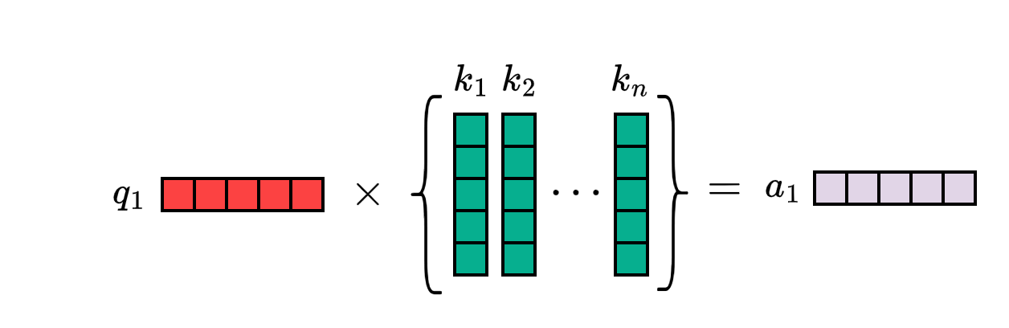
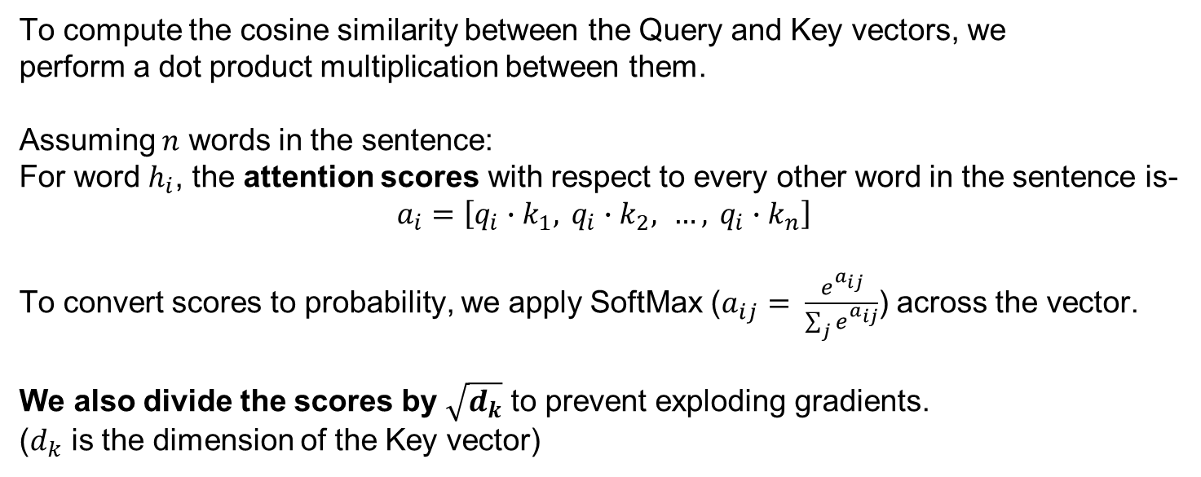
Generative AI and its Applications
Attention
To compute the cosine similarity between the Query and Key vectors, we perform a dot product multiplication between them.
Assuming $n$ words in the sentence:
For word $h_{i}$, the attention scores with respect to every other word in the sentence is-
$$a_{i}=\left[q_{i}∙k_{1}, q_{i}∙k_{2}, …, q_{i}∙k_{n}\right]$$
To convert scores to probability, we apply SoftMax ($a_{ij}= \frac{e^{a_{ij}}}{\sum_{j}{e^{a_{ij}}}}$) across the vector.
We also divide the scores by $\sqrt{d_{k}}$ to prevent exploding gradients.
($d_{k}$ is the dimension of the Key vector)

Slide 42
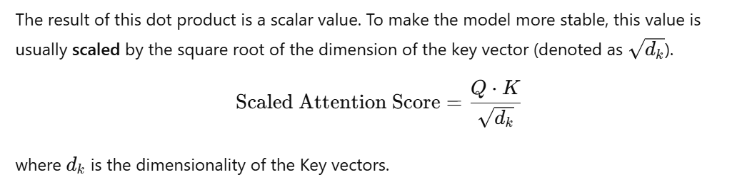
Generative AI and its Applications
Attention

Slide 43
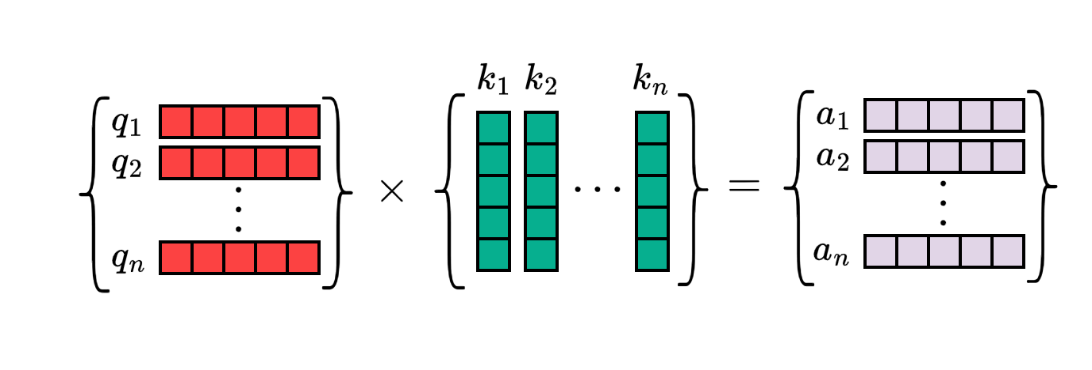
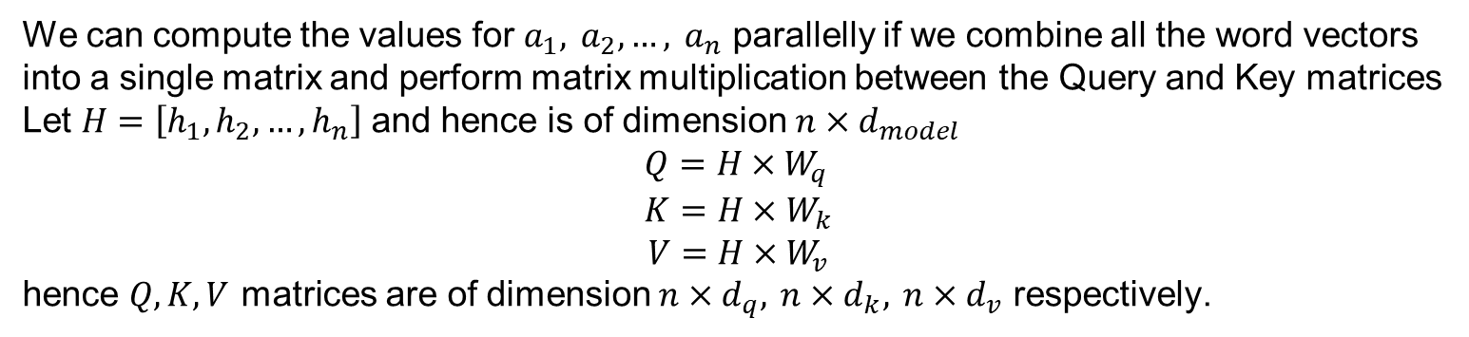
Generative AI and its Applications
Attention
We can compute the values for $a_{1}, a_{2}, …, a_{n}$ parallelly if we combine all the word vectors
into a single matrix and perform matrix multiplication between the Query and Key matrices
Let $H=\left[h_{1},h_{2},…, h_{n}\right]$ and hence is of dimension $n×d_{model}$
$$Q=H×W_{q} \\ K=H×W_{k}$$
$$V=H×W_{v}$$
hence $Q, K, V$ matrices are of dimension $n×d_{q}, n×d_{k}, n×d_{v}$ respectively.

Slide 44
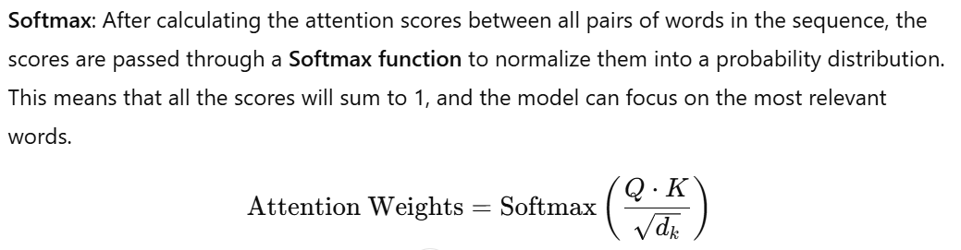
Generative AI and its Applications
Attention

Slide 45
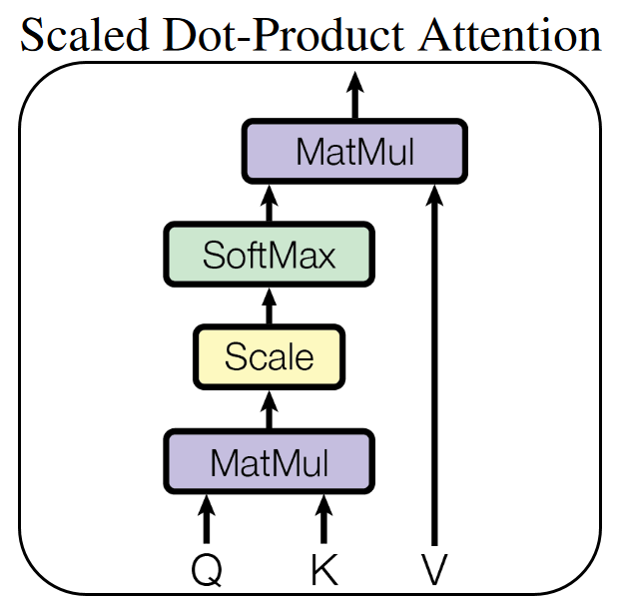
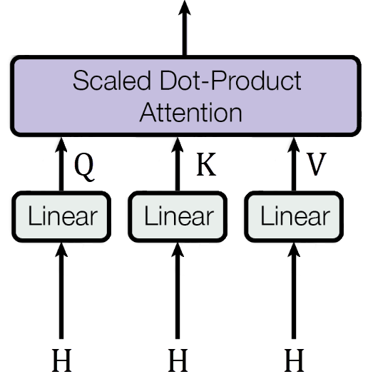
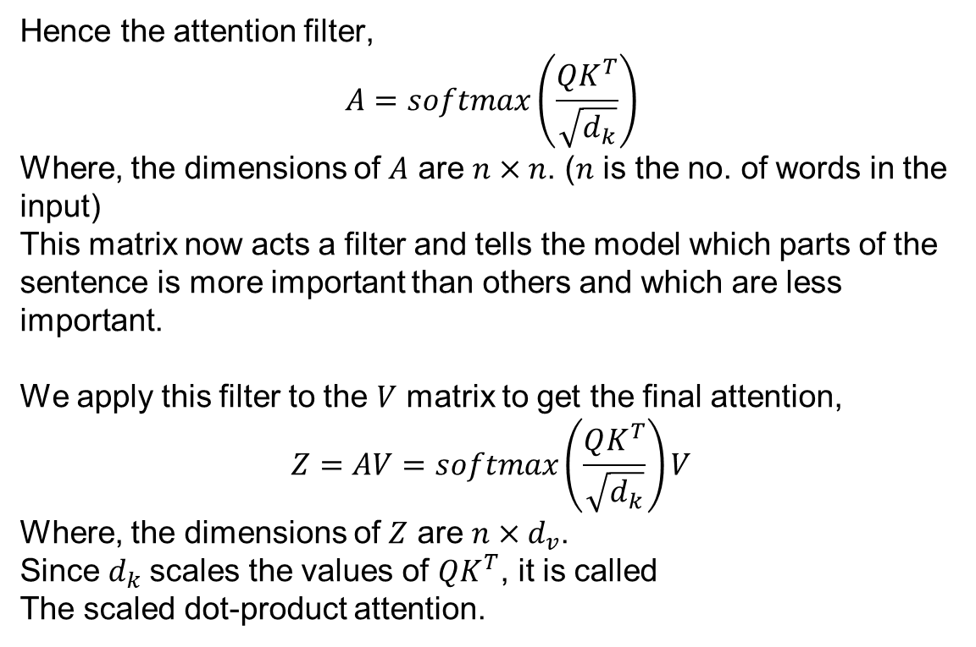
Generative AI and its Applications
Attention
Hence the attention filter,
$$A=softmax\left(\frac{QK^{T}}{\sqrt{d_{k}}}\right)$$
Where, the dimensions of $A$ are $n×n$. ($n$ is the no. of words in the input)
This matrix now acts a filter and tells the model which parts of the
sentence is more important than others and which are less important.
We apply this filter to the $V$ matrix to get the final attention,
$$Z=AV=softmax\left(\frac{QK^{T}}{\sqrt{d_{k}}}\right)V$$
Where, the dimensions of $Z$ are $n×d_{v}$.
Since $d_{k}$scales the values of $QK^{T}$, it is called
The scaled dot-product attention.
Picture Credit

Slide 46
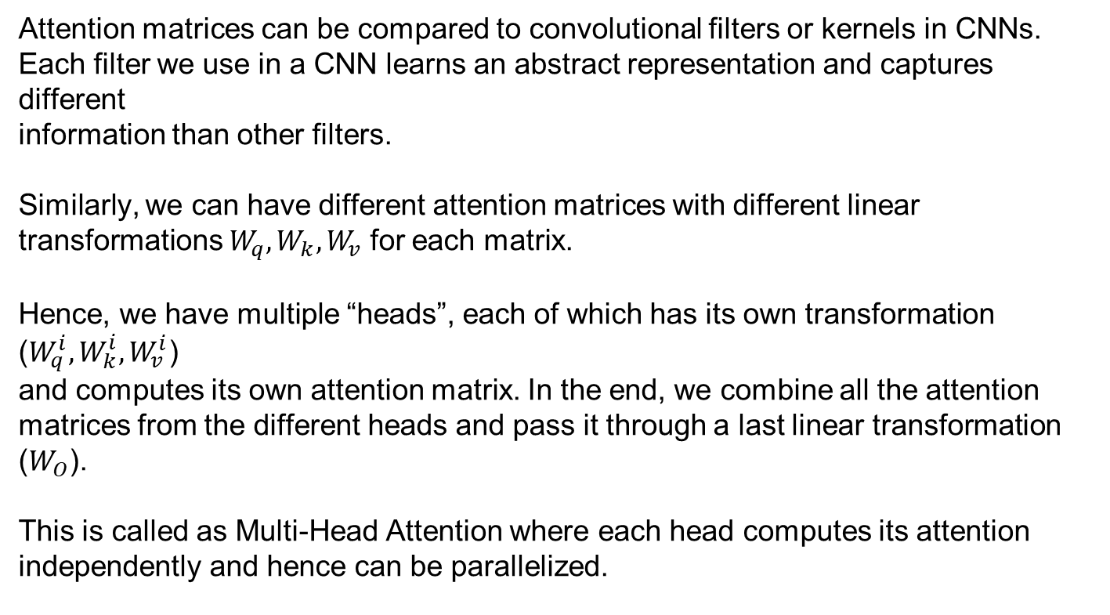
Generative AI and its Applications
Attention
Attention matrices can be compared to convolutional filters or kernels in CNNs.
Each filter we use in a CNN learns an abstract representation and captures different
information than other filters.
Similarly, we can have different attention matrices with different linear transformations $W_{q}, W_{k}, W_{v}$ for each matrix.
Hence, we have multiple “heads”, each of which has its own transformation ($W_{q}^{i}, W_{k}^{i}, W_{v}^{i}$)
and computes its own attention matrix. In the end, we combine all the attention matrices from the different heads and pass it through a last linear transformation ($W_{O}$).
This is called as Multi-Head Attention where each head computes its attention independently and hence can be parallelized.

Slide 47
Generative AI and its Applications
Encoder and Decoder
Encoder is responsible for
processing the input sequence
converting it into a set of continuous representations (or embeddings)
consists of N identical layers, each of which has two main sub-components:
Self-Attention Layer: This layer allows the encoder to consider the entire sequence of input tokens when computing its representation.
Every token in the input can "attend" to all other tokens in the sequence, capturing dependencies and relationships regardless of distance between tokens.
This is done through the scaled dot-product attention mechanism.
The self-attention mechanism works by computing three vectors for each token in the sequence:
Query (Q): Represents the current token.
Key (K): Represents all tokens.
Value (V): Represents the information that will be passed through
Attention is computed by taking the dot product of the query and key vectors, scaling the result, and applying a softmax function to generate attention weights. These weights are used to compute a weighted sum of the value vectors, which forms the new representation for each token.

Slide 48
Generative AI and its Applications
Encoder and Decoder
Feed-Forward Neural Network (FFN): After the self-attention layer,
each token representation is passed through a position-wise feed-forward neural network.
This is applied to each token independently and consists of two fully connected layers with a ReLU activation function in between.
The FFN allows for more complex transformations of the token representations.
Decoder is responsible for
Decoder is responsible for generating the output sequence from the continuous representations produced by the encoder.

Slide 49
Generative AI and its Applications
Encoder and Decoder
Decoder is responsible for
Decoder is responsible for generating the output sequence from the continuous representations produced by the encoder.
Like the encoder, the decoder consists of N identical layers, with each layer having three main sub-components:
Masked Self-Attention Layer: In the decoder, the self-attention mechanism is "masked" to prevent attending to future tokens in the output sequence. The masked self-attention ensures that the prediction for each token is only dependent on the previously generated tokens, not future ones.

Slide 50
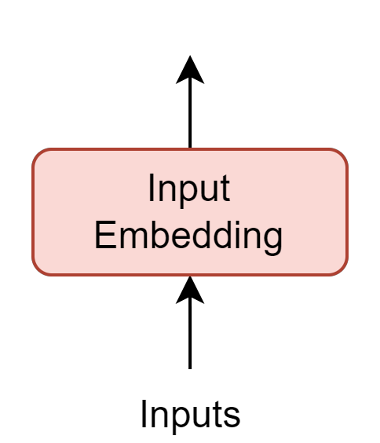
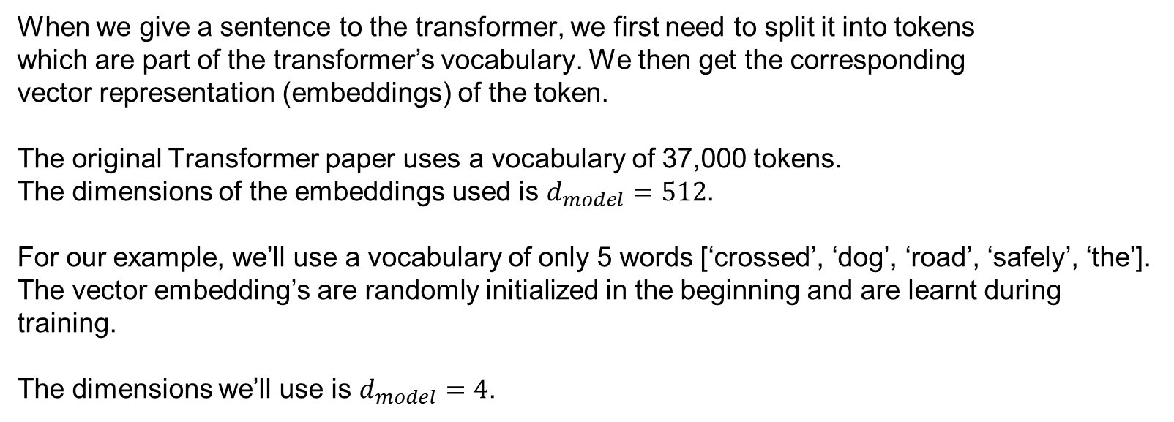
Generative AI and its Applications
Embeddings
When we give a sentence to the transformer, we first need to split it into tokens
which are part of the transformer’s vocabulary. We then get the corresponding
vector representation (embeddings) of the token.
The original Transformer paper uses a vocabulary of 37,000 tokens. The dimensions of the embeddings used is $d_{model}=512$.
For our example, we’ll use a vocabulary of only 5 words [‘crossed’, ‘dog’, ‘road’, ‘safely’, ‘the’].
The vector embedding’s are randomly initialized in the beginning and are learnt during
training.
The dimensions we’ll use is $d_{model}=4$.

Slide 51
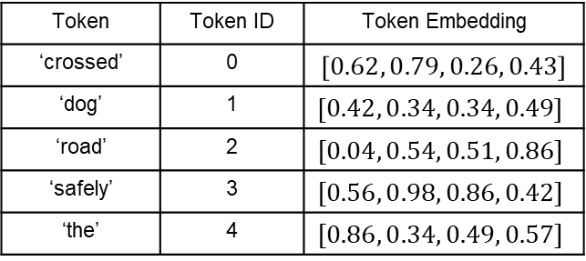
Generative AI and its Applications
Embeddings
Initial Embeddings:
Token | Token ID | Token Embedding
‘crossed’ | 0 | $$\left[0.62, 0.79, 0.26, 0.43\right]$$
‘dog’ | 1 | $$\left[0.42, 0.34, 0.34, 0.49\right]$$
‘road’ | 2 | $$[0.04, 0.54, 0.51, 0.86]$$
‘safely’ | 3 | $$[0.56, 0.98, 0.86, 0.42]$$
‘the’ | 4 | $$[0.86, 0.34, 0.49, 0.57]$$

Slide 52
Generative AI and its Applications
Embeddings
Initial Embeddings:
Token | Token ID | Token Embedding
‘crossed’ | 0 | $$\left[0.62, 0.79, 0.26, 0.43\right]$$
‘dog’ | 1 | $$\left[0.42, 0.34, 0.34, 0.49\right]$$
‘road’ | 2 | $$[0.04, 0.54, 0.51, 0.86]$$
‘safely’ | 3 | $$[0.56, 0.98, 0.86, 0.42]$$
‘the’ | 4 | $$[0.86, 0.34, 0.49, 0.57]$$
So for an Input of “the dog safely”, the following input matrix $H_{n×d_{model}}$ will be generated :

Slide 53

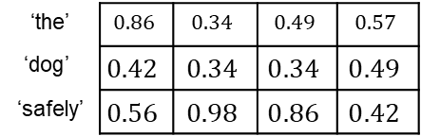
Generative AI and its Applications
Embeddings
Initial Embeddings:
Token | Token ID | Token Embedding
‘crossed’ | 0 | $$\left[0.62, 0.79, 0.26, 0.43\right]$$
‘dog’ | 1 | $$\left[0.42, 0.34, 0.34, 0.49\right]$$
‘road’ | 2 | $$[0.04, 0.54, 0.51, 0.86]$$
‘safely’ | 3 | $$[0.56, 0.98, 0.86, 0.42]$$
‘the’ | 4 | $$[0.86, 0.34, 0.49, 0.57]$$
So for an Input of “the dog safely”, the following input matrix $H_{n×d_{model}}$ will be generated :
‘the’ | $$0.86$$ | $$0.34$$ | $$0.49$$ | $$0.57$$
$$\text{‘}\text{dog}\text{’}$$ | $$0.42$$ | $$0.34$$ | $$0.34$$ | $$0.49$$
‘safely’ | $$0.56$$ | $$0.98$$ | $$0.86$$ | $$0.42$$
$$=H_{3×4}$$

Slide 54
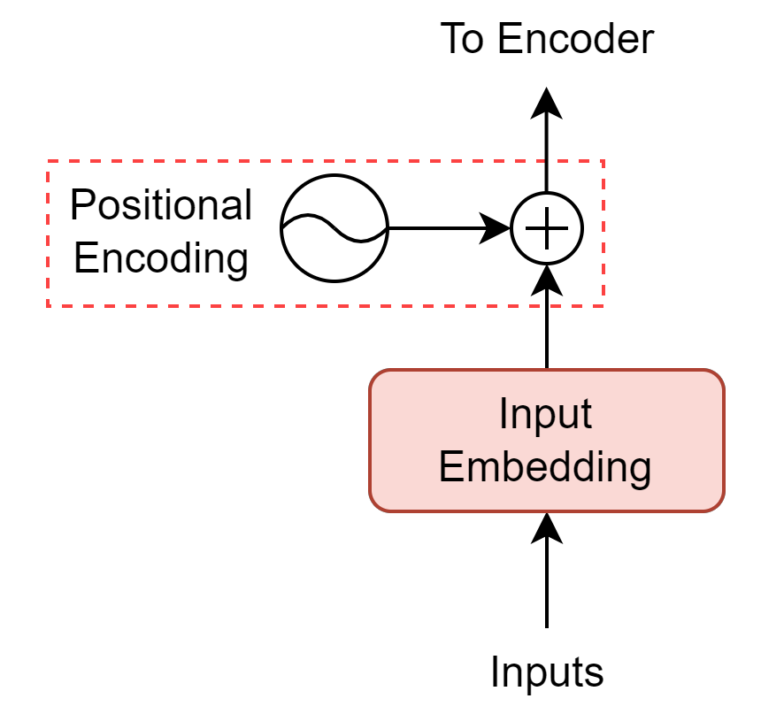
Generative AI and its Applications
Positional Encoding
We need some way of encoding the positional data of the words in the sentence
For example: consider the two sentences-
The coach praised the player because he worked hard.
The coach because he worked hard praised the player.
In the 1st sentence, ‘he’ refers to the player.
But with only a change of position of words,
in the 2nd sentence, ‘he’ refers to the coach.

Slide 55
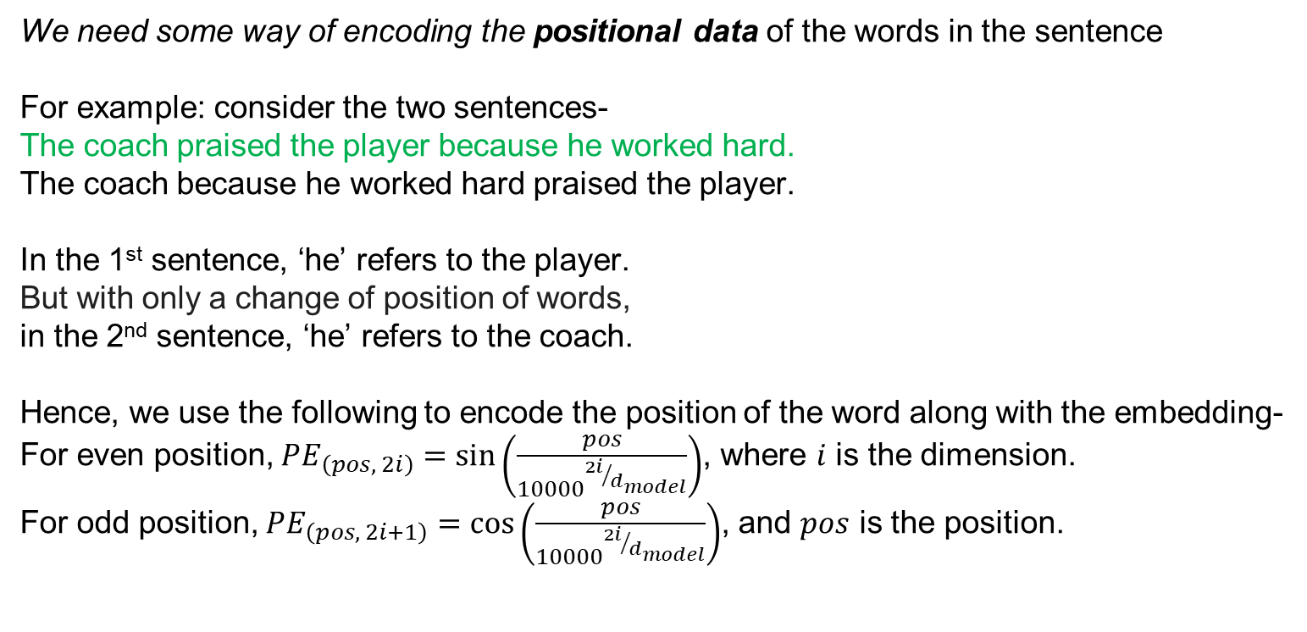
Generative AI and its Applications
Positional Encoding
We need some way of encoding the positional data of the words in the sentence
For example: consider the two sentences-
The coach praised the player because he worked hard.
The coach because he worked hard praised the player.
In the 1st sentence, ‘he’ refers to the player.
But with only a change of position of words,
in the 2nd sentence, ‘he’ refers to the coach.
Hence, we use the following to encode the position of the word along with the embedding-
For even position, $PE_{\left(pos, 2i\right)}=sin⁡\left(\frac{pos}{{10000}^{{2i}/{d_{model}}}}\right)$, where $i$ is the dimension.
For odd position, $PE_{\left(pos, 2i+1\right)}=cos⁡\left(\frac{pos}{{10000}^{{2i}/{d_{model}}}}\right)$, and $pos$ is the position.

Slide 56
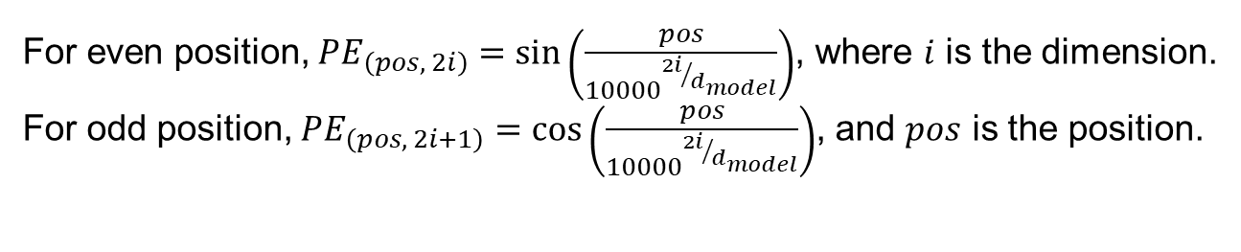
Generative AI and its Applications
Positional Encoding
For even position, $PE_{\left(pos, 2i\right)}=sin⁡\left(\frac{pos}{{10000}^{{2i}/{d_{model}}}}\right)$, where $i$ is the dimension.
For odd position, $PE_{\left(pos, 2i+1\right)}=cos⁡\left(\frac{pos}{{10000}^{{2i}/{d_{model}}}}\right)$, and $pos$ is the position.
So, for our example [‘the’, ‘dog’, ‘safely’]:
‘the’ is in position 0 -

Slide 57
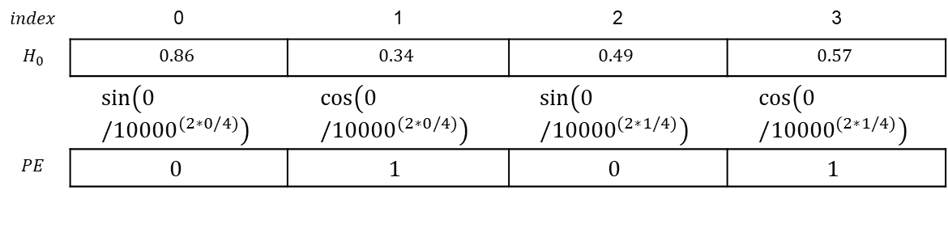
Generative AI and its Applications
Positional Encoding
For even position, $PE_{\left(pos, 2i\right)}=sin⁡\left(\frac{pos}{{10000}^{{2i}/{d_{model}}}}\right)$, where $i$ is the dimension.
For odd position, $PE_{\left(pos, 2i+1\right)}=cos⁡\left(\frac{pos}{{10000}^{{2i}/{d_{model}}}}\right)$, and $pos$ is the position.
So, for our example [‘the’, ‘dog’, ‘safely’]:
‘the’ is in position 0 -
$$index$$ | 0 | 1 | 2 | 3
$$H_{0}$$ | $$0.86$$ | $$0.34$$ | $$0.49$$ | $$0.57$$
 | $$sin⁡\left(0/{10000}^{(2∗0/4)}\right)$$ | $$cos⁡\left(0/{10000}^{(2∗0/4)}\right)$$ | $$sin⁡\left(0/{10000}^{(2∗1/4)}\right)$$ | $$cos⁡\left(0/{10000}^{(2∗1/4)}\right)$$
$$PE$$ | $$0$$ | $$1$$ | $$0$$ | $$1$$

Slide 58
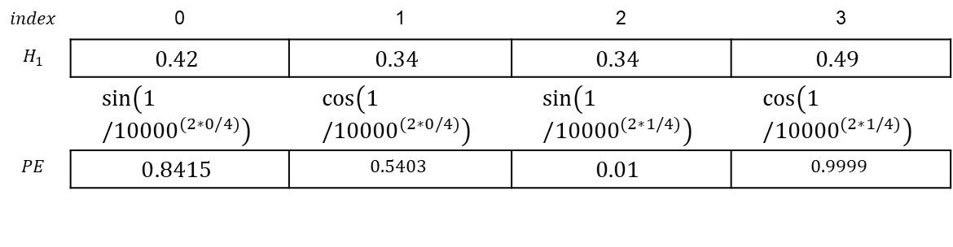
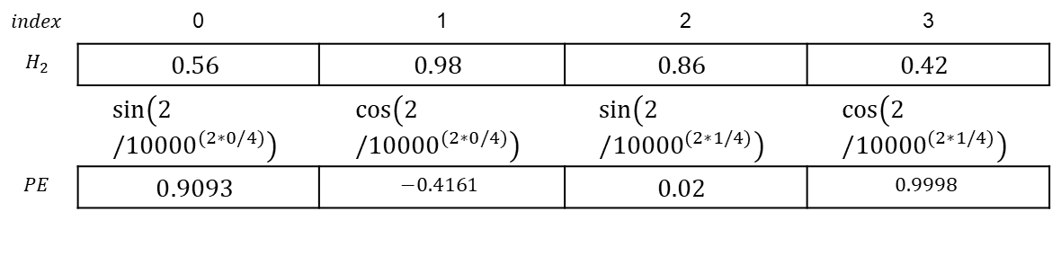
Generative AI and its Applications
Positional Encoding
‘dog’ is in position 1 -
$$index$$ | 0 | 1 | 2 | 3
$$H_{1}$$ | $$0.42$$ | $$0.34$$ | $$0.34$$ | $$0.49$$
 | $$sin⁡\left(1/{10000}^{(2∗0/4)}\right)$$ | $$cos⁡\left(1/{10000}^{(2∗0/4)}\right)$$ | $$sin⁡\left(1/{10000}^{(2∗1/4)}\right)$$ | $$cos⁡\left(1/{10000}^{(2∗1/4)}\right)$$
$$PE$$ | $$0.8415$$ | $$0.5403$$ | $$0.01$$ | $$0.9999$$
‘safely’ is in position 2 -
$$index$$ | 0 | 1 | 2 | 3
$$H_{2}$$ | $$0.56$$ | $$0.98$$ | $$0.86$$ | $$0.42$$
 | $$sin⁡\left(2/{10000}^{(2∗0/4)}\right)$$ | $$cos⁡\left(2/{10000}^{(2∗0/4)}\right)$$ | $$sin⁡\left(2/{10000}^{(2∗1/4)}\right)$$ | $$cos⁡\left(2/{10000}^{(2∗1/4)}\right)$$
$$PE$$ | $$0.9093$$ | $$−0.4161$$ | $$0.02$$ | $$0.9998$$

Slide 59
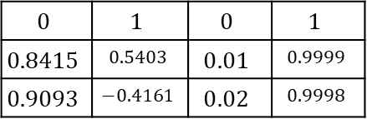


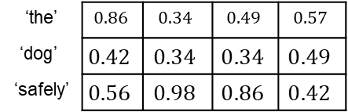
Generative AI and its Applications
Positional Encoding
We finally add the $PE$ with the input embeddings:
$$H_{3×4}=H_{3×4}+PE$$
‘the’ | $$0.86$$ | $$0.34$$ | $$0.49$$ | $$0.57$$
$$\text{‘}\text{dog}\text{’}$$ | $$0.42$$ | $$0.34$$ | $$0.34$$ | $$0.49$$
‘safely’ | $$0.56$$ | $$0.98$$ | $$0.86$$ | $$0.42$$
$$0$$ | $$1$$ | $$0$$ | $$1$$
$$0.8415$$ | $$0.5403$$ | $$0.01$$ | $$0.9999$$
$$0.9093$$ | $$−0.4161$$ | $$0.02$$ | $$0.9998$$
$$+$$

Slide 60

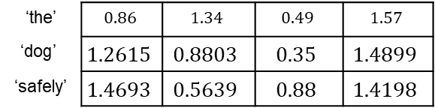
Generative AI and its Applications
Positional Encoding
We finally add the $PE$ with the input embeddings:
$$H_{3×4}=H_{3×4}+PE$$
‘the’ | $$0.86$$ | $$0.34$$ | $$0.49$$ | $$0.57$$
$$\text{‘}\text{dog}\text{’}$$ | $$0.42$$ | $$0.34$$ | $$0.34$$ | $$0.49$$
‘safely’ | $$0.56$$ | $$0.98$$ | $$0.86$$ | $$0.42$$
$$0$$ | $$1$$ | $$0$$ | $$1$$
$$0.8415$$ | $$0.5403$$ | $$0.01$$ | $$0.9999$$
$$0.9093$$ | $$−0.4161$$ | $$0.02$$ | $$0.9998$$
$$+$$
‘the’ | $$0.86$$ | $$1.34$$ | $$0.49$$ | $$1.57$$
$$\text{‘}\text{dog}\text{’}$$ | $$1.2615$$ | $$0.8803$$ | $$0.35$$ | $$1.4899$$
‘safely’ | $$1.4693$$ | $$0.5639$$ | $$0.88$$ | $$1.4198$$
$$H_{3×4}=$$

Slide 61
Generative AI and its Applications
Transformer Anatomy
Transformer Architecture
Transformer is a deep learning model introduced in the 2017 paper "Attention Is All You Need". It has become the foundation for most modern large language models (LLMs) due to its efficiency and effectiveness in handling sequential data, such as text.
Originally, it was designed for machine translation, where it translated text from one language (e.g., English) to another (e.g., German or French).
The Transformer consists of two main parts:
Encoder: Processes the input text and converts it into a numerical representation (embedding).
Decoder: Uses the encoded representation to generate the output text, one word at a time.

Slide 62
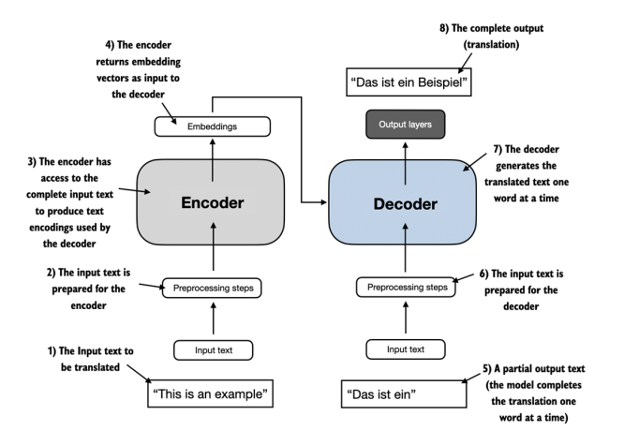
Generative AI and its Applications
Transformer Anatomy
Transformer Architecture
A simplified diagram taken from:
Book: Build a Large Language Model (From Scratch)
References:
Book: Build a Large Language Model (From Scratch)

Slide 63
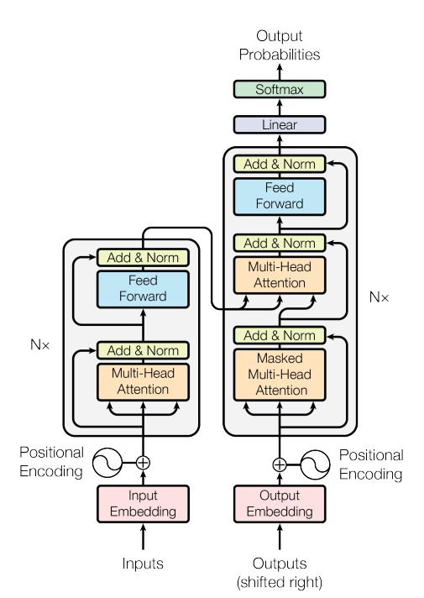
Generative AI and its Applications
Transformer Anatomy
Transformer Architecture
Original diagram from the paper:
Source
References:
Book: Build a Large Language Model (From Scratch)

Slide 64
Generative AI and its Applications
Transformer Anatomy
How the Transformer Works
Encoder:
The encoder takes the input text (e.g., "This is an example") and converts it into a series of numerical vectors.
These vectors capture the contextual meaning of the input text, considering the relationships between words.
The encoder consists of multiple layers, each using a mechanism called self-attention to focus on the most important parts of the input text.
References:
Book: Build a Large Language Model (From Scratch)

Slide 65
Generative AI and its Applications
Transformer Anatomy
How the Transformer Works
Decoder:
The decoder takes the encoded vectors from the encoder and generates the output text (e.g., "Das ist ein Beispiel").
It generates the output one word at a time, using the context provided by the encoder and the words it has already generated.
Like the encoder, the decoder also uses self-attention to focus on relevant parts of the input and previously generated output.
References:
Book: Build a Large Language Model (From Scratch)

Slide 66
Generative AI and its Applications
Transformer Anatomy
Self-Attention Mechanism
A key innovation of the Transformer is the self-attention mechanism.
What it does:
It allows the model to weigh the importance of different words in a sequence relative to each other.
For example, in the sentence "The cat sat on the mat," the word "cat" is more important to "sat" than "mat" when determining the meaning of the sentence.
Why it matters:
It enables the model to capture long-range dependencies (e.g., relationships between words far apart in a sentence).
This improves the model's ability to understand context and generate coherent, contextually relevant output.

Slide 67
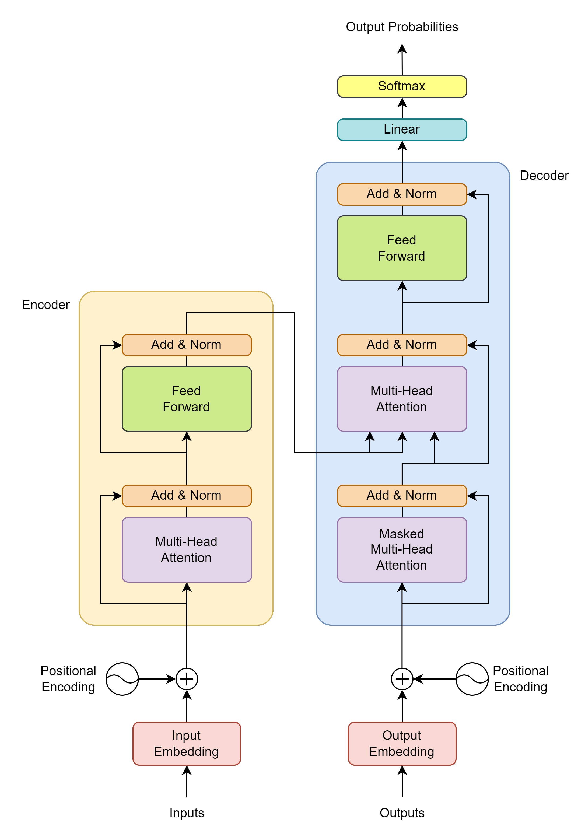
Generative AI and its Applications
Architecture of Transformers
Embeddings
Positional Encoding
Encoder Components-
Multi-Head (Self) Attention
Fully Connected Feed Forward Network
Residual Connections & Layer Normalization
Decoder Components-
Masked Multi-Head (Self) Attention
Multi-Head (Cross) Attention
Final Linear & SoftMax Layer

Slide 68
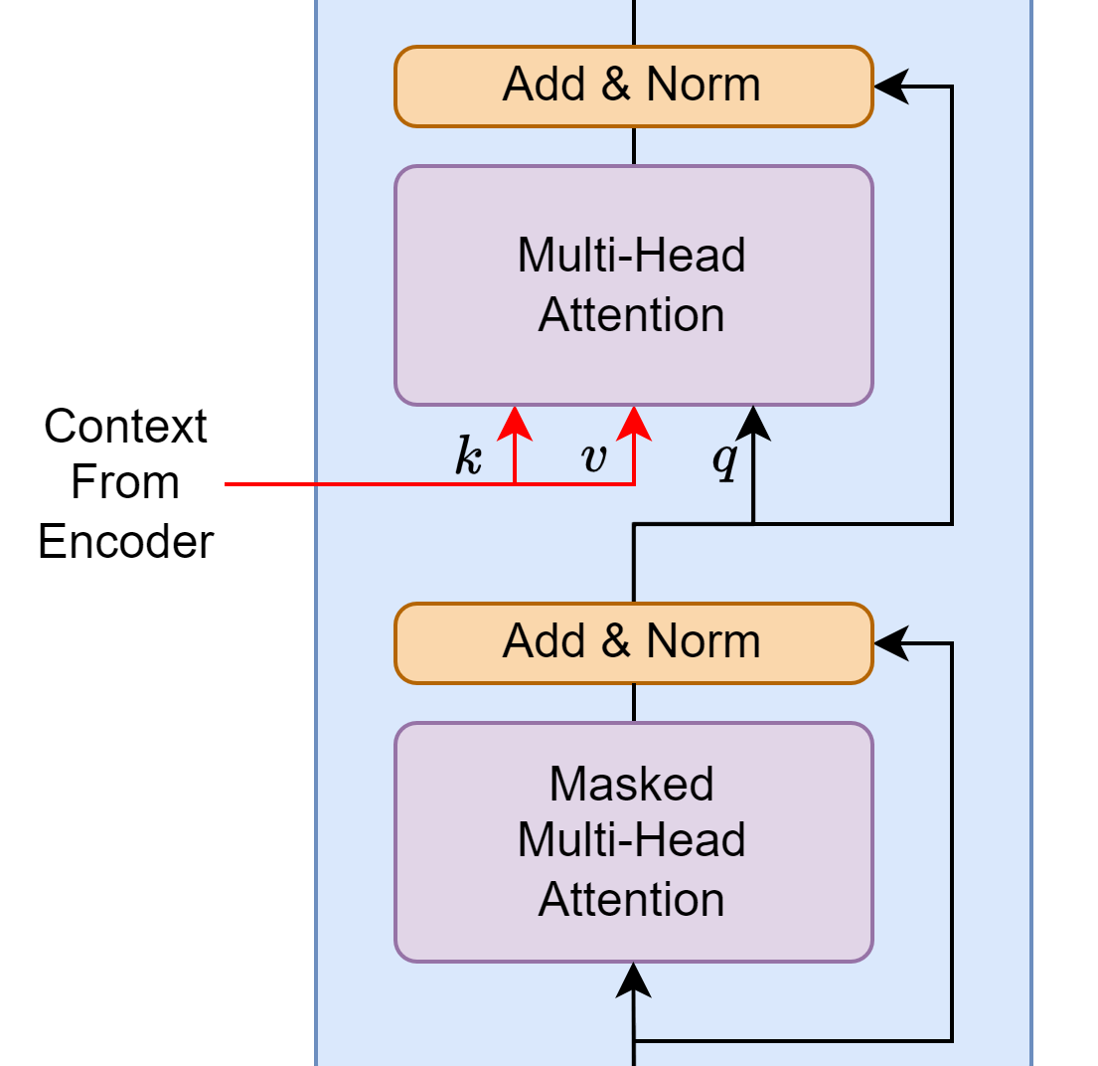
Generative AI and its Applications
Decoder – Multi-Head (Cross) attention
The second Multi-Head attention module in the layer is slightly different.
It takes the Keys & Values from the encoder module
and the Query from the previous multi-head attention
module in the layer.
Since the Query (from decoder) is being performed on
a Key (from encoder), this is called cross attention.

Slide 69
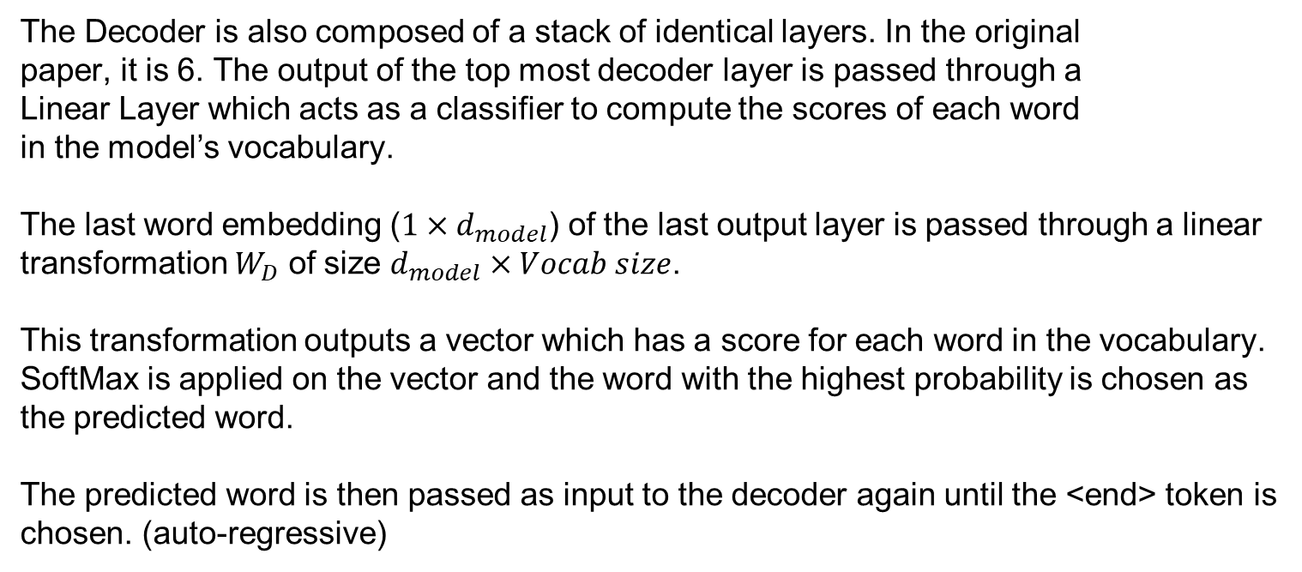
Generative AI and its Applications
Final Layer
The Decoder is also composed of a stack of identical layers. In the original
paper, it is 6. The output of the top most decoder layer is passed through a
Linear Layer which acts as a classifier to compute the scores of each word
in the model’s vocabulary.
The last word embedding ($1×d_{model}$) of the last output layer is passed through a linear
transformation $W_{D}$ of size $d_{model}×Vocab size$.
This transformation outputs a vector which has a score for each word in the vocabulary.
SoftMax is applied on the vector and the word with the highest probability is chosen as
the predicted word.
The predicted word is then passed as input to the decoder again until the <end> token is
chosen. (auto-regressive)

Slide 70
Generative AI and its Applications
Example

Slide 71
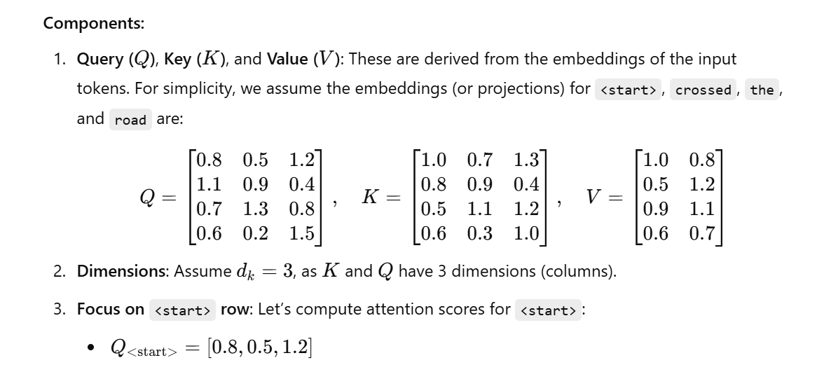
Generative AI and its Applications
Example

Slide 72


Generative AI and its Applications
Example

Slide 73

Generative AI and its Applications

Slide 74

Generative AI and its Applications

Slide 75


Generative AI and its Applications

Slide 76


Generative AI and its Applications

Slide 77



Generative AI and its Applications
 | <start> | ‘crossed’ | ‘the’ | ‘road’
<start> | $$0.8408$$ | $$2.0970$$ | $$2.7278$$ | $$2.7686$$
‘crossed’ | $$0.1084$$ | $$1.2778$$ | $$−0.2488$$ | $$−1.1374$$
‘the’ | $$1.2523$$ | $$2.7686$$ | $$3.7890$$ | $$0.4894$$
‘road’ | $$1.2608$$ | $$−0.2271$$ | $$−1.1589$$ | $$0.6870$$
$$\frac{QK^{T}}{\sqrt{d_{k}}}=$$
 | <start> | ‘crossed’ | ‘the’ | ‘road’
<start> | $$0.8408$$ | $$−∞$$ | $$−∞$$ | $$−∞$$
‘crossed’ | $$0.1084$$ | $$1.2778$$ | $$−∞$$ | $$−∞$$
‘the’ | $$1.2523$$ | $$2.7686$$ | $$3.7890$$ | $$−∞$$
‘road’ | $$1.2608$$ | $$−0.2271$$ | $$−1.1589$$ | $$0.6870$$

Slide 78




Generative AI and its Applications
By placing $−∞$ in the places where we don’t want the model to know the
attention scores, SoftMax computes them as 0, and hence future words are
successfully hidden from the model.
 | <start> | ‘crossed’ | ‘the’ | ‘road’
<start> | $$0.8408$$ | $$−∞$$ | $$−∞$$ | $$−∞$$
‘crossed’ | $$0.1084$$ | $$1.2778$$ | $$−∞$$ | $$−∞$$
‘the’ | $$1.2523$$ | $$2.7686$$ | $$3.7890$$ | $$−∞$$
‘road’ | $$1.2608$$ | $$−0.2271$$ | $$−1.1589$$ | $$0.6870$$
 | <start> | ‘crossed’ | ‘the’ | ‘road’
<start> | $$1$$ | $$0$$ | $$0$$ | $$0$$
‘crossed’ | $$0.2370$$ | $$0.7630$$ | $$0$$ | $$0$$
‘the’ | $$0.0550$$ | $$0.2504$$ | $$0.6946$$ | $$0$$
‘road’ | $$0.5324$$ | $$0.1202$$ | $$0.0474$$ | $$0.3$$
$$softmax$$

Slide 79

Thank You

